Slide 1
WTF is AML? (And why should crypto companies care?)
Presented by:
Amber D. Scott
Founder, CEO & Chief AML Ninja

Slide 2
Cypherpunk Love
Privacy is the power to selectively reveal oneself to the world (A Cypherpunk's Manifesto)
You have my consent for photos, videos etc. but you do not have consent from everyone in the audience.

Slide 3
Hefty Disclaimers
I am not a lawyer and nothing that I say should be interpreted as legal advice.
I do not represent any government or government agency. Nothing that I say should be interpreted as an official government statement or position.
If you have questions about a particular situation or company that involve people’s names or confidential information, come and chat me up after the presentation instead of asking in a public forum.
Information should be free. If you want to use any aspect of this presentation, I’ll send you a copy. I’d love to be credited for my work, but when I’m not I probably won’t notice and I definitely won’t send an army of lawyers.

Slide 4
What’s Happening?
In 2014, Bill-C-31 stated that “dealing in virtual currency” would be regulated as money services business (MSB)… but that wouldn’t be in force until there were amendments to other legislation…
Draft amendments have been published here: http://www.gazette.gc.ca/rp-pr/p1/2018/2018-06-09/html/reg1-eng.html

Slide 5
Process and Timelines
Draft published: June 9, 2018
Comment Period: 90 days
Then what: Department of Finance goes back to the bat cave to read, synthesize, update… and publish a final version (expected soon-ish).
After that: when the final version is published, there will be a 12 month transition period to comply.

Slide 6
MSB Basics
Compliance Program
Operations
Compliance Officer
Policies & Procedures
Risk Assessment
Training
Effectiveness Review
Customer Identification & Information
Recordkeeping
Reporting
MSB Registration
Learn more about MSBs:
http://www.fintrac.gc.ca/msb-esm/intro-eng.asp

Slide 7
Virtual Currency
(a) a digital currency that is not a fiat currency and that can be readily exchanged for funds or for another virtual currency that can be readily exchanged for funds; or
(b) information that enables a person or entity to have access to a digital currency referred to in paragraph (a).

Slide 8
Not Virtual Currency
funds means
(a) cash and other fiat currencies, and securities, negotiable instruments or other financial instruments that indicate a title or right to or interest in them; or
(b) information that enables a person or entity to have access to a fiat currency other than cash.
For greater certainty, it does not include virtual currency. (fonds)
fiat currency means a currency that is issued by a country and is designated as legal tender in that country. (monnaie fiduciaire)

Slide 9
“Dealing in Virtual Currency”
Not defined, but contextually appears to refer to:
Exchange,
Sending, and/or
Receiving.
On behalf of another person or entity…

Slide 10
Astute Exclusions
(a) a transfer or receipt of virtual currency as compensation for the validation of a transaction that is recorded in a distributed ledger; or
(b) an exchange, transfer or receipt of a nominal amount of virtual currency for the sole purpose of validating another transaction or a transfer of information .

Slide 11
Virtual Currency Exchange Transaction
…means an exchange, at the request of another person or entity, of virtual currency for funds, funds for virtual currency or one virtual currency for another.
Requires the creation of a virtual currency exchange transaction ticket.
Requires identification if the value is CAD 1,000 or more.

Slide 12
Large Virtual Currency Transactions
Valued at CAD 10,000 or more (within a 24-hour period) by or on behalf of the same person or entity.
Requires a determination of whether the transaction is being conducted on one’s own behalf (and compels the collection of additional information if not).

Slide 13
Politically Exposed Persons
Requirements to determine if a person is a politically exposed person (PEP), either domestic or foreign, the head of an international organization (HIO, family member, or close associate) for virtual currency transactions valued at CAD 100,000 or more.
If so, source of virtual currency (specifically) and wealth (generally) must be established.

Slide 14
Foreign Companies
Included in the amendments if they are providing MSB services (including dealing in virtual currencies) to Canadian customers.

Slide 15
Do you want to talk about Quadriga?
What could other crypto companies have done differently?
What should we be doing differently now?
Is immediate and harsh regulation imminent as a result?

Slide 16
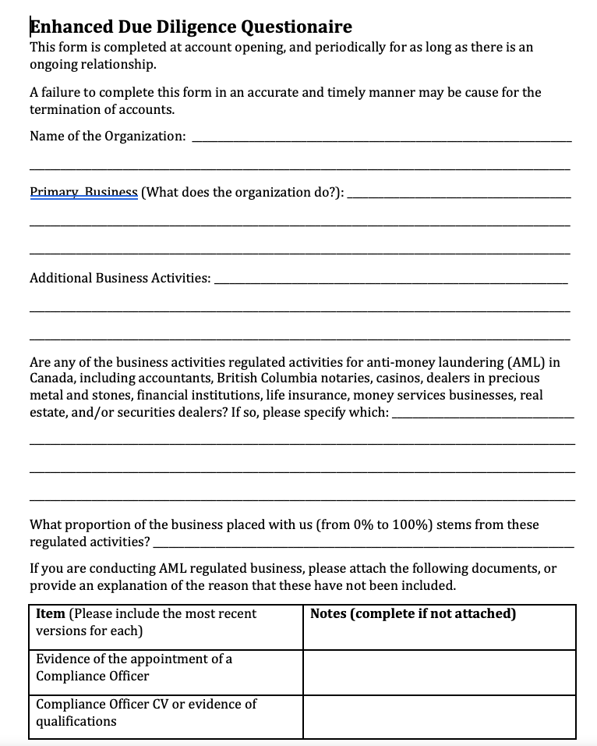
Free to a good home… Supplier Vetting Forms
Highly modified version of the Wolfsburg questionnaire, emulating the processes used by banks.
This is not a perfect solution, but it can help you demonstrate that you’ve done some due diligence.

Slide 17
Questions?
Please note:
We’re on a tight timeline.
Questions should be actual questions.
If you want me to listen to a diatribe about how regulation is not always logical or inline with technology, you must first ply me with high end wine.
I’m a big fan of old vine varietals from the Russian River Valley, and sushi.

Slide 18

Contact
Amber D. Scott
Amber@outliercanada.com
www.outliercanada.com
(416) 919-1623
@OutlierCanada

